Slide 1

An Independent Validation of the Kidney Failure Risk Equation (KFRE) on a Seoul University Hospital Population Using Python
Leonid Shpaner, M.S.

Slide 2
Background
KFRE Overview:
Developed by Tangri et al. to predict the risk of progression to kidney failure in CKD patients (stages 3 to 5).
Key predictors identified: age, sex, eGFR, and urine albumin-to-creatinine ratio (ACR).
Model Details:
KFRE estimates the risk of kidney failure at 2 and 5 years using statistical modeling.
The equation has been validated across various populations and is widely used for clinical decision-making and patient counseling.

Slide 3
Methods
Python Library Implementation
A Python library, kfre, has been created to replicate the original KFRE equations.
The library supports calculations for the 2-year and 5-year risk using:
4-variable equation: age, sex, eGFR, uACR.
6-variable equation: Adds diabetes mellitus and hypertension.
8-variable equation: Includes all from the 4-variable model plus serum albumin, serum phosphorous, serum bicarbonate, and calcium.
Application
The kfre library enables healthcare professionals and researchers to integrate KFRE calculations into their analyses and decision-making processes.
Further Information
A detailed usage guide is available at the official documentation: kfre Documentation.

Slide 4
Preprocessing
Create Randomized Patient IDs for Indexing - crucial for several reasons:
Privacy and Anonymity: Random patient IDs help protect patient privacy and maintain anonymity. This is particularly important in healthcare research to ensure compliance with data protection regulations such as HIPAA.
Avoiding Bias: Randomly generated IDs prevent any unintentional bias that could be introduced by using sequential or otherwise patterned IDs. This ensures that analyses are not influenced by the ordering of data.
Data Integrity: Using random IDs can help maintain data integrity when merging datasets from different sources. It reduces the risk of conflicts or duplicates that could arise from overlapping or sequential IDs.
Scalability: Random IDs make it easier to scale the dataset as new patient records can be added without worrying about maintaining a specific order or sequence.
By using random patient IDs, we can enhance the robustness, security, and scalability of our data management processes.

Slide 5
Preprocessing
randomly generated (anonymized) patient ids
 | Age | SEX | HTN | DM | GFR | uACR | ACR | Ca | P | Alb | TCO2 | ESRD | ESRD_dur
Patient_ID
867721094 | 61 | 1 | 1 | 0 | 9.148234 | 10 | 10 | 6 | 4 | 2.6 | 16 | 0 | 2086
533512602 | 30 | 0 | 1 | 1 | 153.9749 | 29 | 29 | 9.4 | 4.5 | 4 | 24 | 0 | 2357
988350865 | 55 | 1 | 0 | 0 | 66.81041 |  | 25.77426 | 9.2 | 1.6 | 4.3 | 18 | 0 | 265
428707535 | 35 | 1 | 0 | 0 | 89.34706 |  | 28.4513 | 10.5 | 2.9 | 5 | 26 | 0 | 700
813646552 | 66 | 1 | 1 | 0 | 7.316171 | 0 | 0 | 7.7 | 6.5 | 3.5 | 14 | 1 | 3

Slide 6
Preprocessing
Tangri et al. used years to determine outcome for 2-years, and 5-years, respectively, so we will have to convert days to years.
The class_esrd_outcome() function below creates a new column called years that converts ESRD_dur.
Now we use the years column to classify the ESRD column into two new columns inside df called 2_year_outcome and 5_year_outcome given the constrains above.
ESRD_in_2_year_outcome | ESRD_in_5_year_outcome
0 | 0
0 | 0
0 | 0
0 | 0
1 | 1

Slide 7
Preprocessing
Patient_ID | Age | HTN | DM | GFR | ACR | Ca | P | Alb | TCO2 | ESRD | ESRD_dur | Sex | kfre_4var_2year | kfre_4var_5year | kfre_6var_2year | kfre_6var_5year | kfre_8var_2year | kfre_8var_5year
829432911 | 61 | 1 | 0 | 9.15 | 10 | 6 | 4 | 2.6 | 16 | 0 | 2086 | Male | 0.1218 | 0.3953 | 0.1319 | 0.4155 | 0.5811 | 0.9800
451074312 | 66 | 1 | 0 | 7.32 | 0 | 7.7 | 6.5 | 3.5 | 14 | 1 | 3 | Male | 0.0001 | 0.0004 | 0.0001 | 0.0004 | 0.0046 | 0.0207
472425367 | 70 | 1 | 0 | 10.12 | 0 | 7.5 | 3.8 | 3.2 | 17 | 1 | 93 | Male | 0.0001 | 0.0003 | 0.0001 | 0.0003 | 0.0015 | 0.0067
300680837 | 49 | 0 | 0 | 7.63 | 0 | 8.5 | 5.4 | 4.3 | 23 | 1 | 138 | Female | 0.0001 | 0.0004 | 0.0001 | 0.0004 | 0.0013 | 0.0059
105959696 | 54 | 1 | 1 | 11.34 | 0 | 8 | 5.1 | 2.9 | 20 | 1 | 311 | Male | 0.0001 | 0.0003 | 0.0001 | 0.0003 | 0.0020 | 0.0091
205521453 | 56 | 0 | 1 | 34.90 | 0 | 8.6 | 3 | 3.2 | 13 | 1 | 461 | Male | 0.0000 | 0.0000 | 0.0000 | 0.0000 | 0.0001 | 0.0007
964175840 | 62 | 1 | 1 | 43.62 | 0 | 9.2 | 3.8 | 4.3 | 26 | 1 | 1312 | Male | 0.0000 | 0.0000 | 0.0000 | 0.0000 | 0.0000 | 0.0001
366215045 | 73 | 1 | 0 | 19.63 | 0 | 7.7 | 2.9 | 2.4 | 14 | 1 | 1566 | Male | 0.0000 | 0.0001 | 0.0000 | 0.0001 | 0.0007 | 0.0031
703995795 | 28 | 1 | 0 | 47.68 | 0 | 9.8 | 3.7 | 4.8 | 28 | 1 | 1587 | Male | 0.0000 | 0.0000 | 0.0000 | 0.0000 | 0.0000 | 0.0001
193572795 | 25 | 1 | 0 | 7.20 | 0 | 8.4 | 5.3 | 4.2 | 19 | 1 | 1705 | Male | 0.0002 | 0.0010 | 0.0002 | 0.0009 | 0.0036 | 0.0162
140269431 | 64 | 1 | 1 | 53.15 | 0 | 9.3 | 4.3 | 3.7 | 25 | 1 | 1958 | Female | 0.0000 | 0.0000 | 0.0000 | 0.0000 | 0.0000 | 0.0000
167087450 | 69 | 1 | 1 | 58.17 | 0 | 9.7 | 3.4 | 4.7 | 25 | 1 | 2856 | Male | 0.0000 | 0.0000 | 0.0000 | 0.0000 | 0.0000 | 0.0000
548454181 | 23 | 1 | 0 | 28.81 | 0 | 7 | 6.8 | 1.7 | 20 | 1 | 3224 | Male | 0.0000 | 0.0001 | 0.0000 | 0.0001 | 0.0020 | 0.0089
780327933 | 67 | 0 | 1 | 29.83 | 0 | 7.9 | 2.2 | 2.8 | 14 | 0 | 28 | Female | 0.0000 | 0.0000 | 0.0000 | 0.0000 | 0.0002 | 0.0008
586810087 | 67 | 1 | 0 | 47.63 | 0 | 9.4 | 3.7 | 4 | 30 | 0 | 114 | Female | 0.0000 | 0.0000 | 0.0000 | 0.0000 | 0.0000 | 0.0000
128191268 | 71 | 1 | 0 | 47.07 | 0 | 9.3 | 4.1 | 4.8 | 22 | 0 | 210 | Female | 0.0000 | 0.0000 | 0.0000 | 0.0000 | 0.0000 | 0.0000
354037890 | 77 | 1 | 0 | 44.77 | 0 | 8.4 | 1.6 | 2.4 | 18 | 0 | 322 | Male | 0.0000 | 0.0000 | 0.0000 | 0.0000 | 0.0000 | 0.0001
325811054 | 67 | 0 | 0 | 58.52 | 0 | 10.1 | 2.9 | 4.2 | 26 | 0 | 418 | Male | 0.0000 | 0.0000 | 0.0000 | 0.0000 | 0.0000 | 0.0000
290397253 | 71 | 1 | 0 | 42.44 | 0 | 9.1 | 3.1 | 4.2 | 31 | 0 | 439 | Male | 0.0000 | 0.0000 | 0.0000 | 0.0000 | 0.0000 | 0.0000
340488662 | 71 | 1 | 1 | 49.03 | 0 | 9.7 | 2.9 | 4.5 | 29 | 0 | 756 | Male | 0.0000 | 0.0000 | 0.0000 | 0.0000 | 0.0000 | 0.0000
852670690 | 71 | 1 | 1 | 57.84 | 0 | 8.9 | 1.6 | 4.2 | 28 | 0 | 1215 | Male | 0.0000 | 0.0000 | 0.0000 | 0.0000 | 0.0000 | 0.0000
532777291 | 83 | 0 | 1 | 41.12 | 0 | 8.4 | 2.7 | 3.7 | 22 | 0 | 1267 | Male | 0.0000 | 0.0000 | 0.0000 | 0.0000 | 0.0000 | 0.0001
770017136 | 73 | 1 | 0 | 48.76 | 0 | 9.5 | 4.9 | 3.8 | 21 | 0 | 1323 | Male | 0.0000 | 0.0000 | 0.0000 | 0.0000 | 0.0000 | 0.0001
845855347 | 28 | 1 | 0 | 31.17 | 0 | 10.3 | 4.7 | 2.5 | 27 | 0 | 1370 | Female | 0.0000 | 0.0000 | 0.0000 | 0.0000 | 0.0002 | 0.0007
259011659 | 63 | 0 | 0 | 59.52 | 0 | 9.6 | 4.2 | 4.4 | 26 | 0 | 1620 | Female | 0.0000 | 0.0000 | 0.0000 | 0.0000 | 0.0000 | 0.0000
451920450 | 71 | 1 | 1 | 27.19 | 0 | 8.9 | 3.5 | 3.9 | 23 | 0 | 1680 | Male | 0.0000 | 0.0000 | 0.0000 | 0.0000 | 0.0001 | 0.0004
971884645 | 65 | 1 | 0 | 22.52 | 0 | 9.1 | 4.1 | 4 | 25 | 0 | 1911 | Male | 0.0000 | 0.0001 | 0.0000 | 0.0001 | 0.0002 | 0.0007
340172975 | 66 | 0 | 1 | 58.96 | 0 | 9.2 | 3.1 | 3.7 | 14 | 0 | 2013 | Female | 0.0000 | 0.0000 | 0.0000 | 0.0000 | 0.0000 | 0.0000

Slide 8
Results
We define truth for 2-year and 5-year outcomes
Filter down the dataset to CKD stages 3-5 (Tangri et al.)
Extract the true labels for the 2-year and 5-year outcomes from the DataFrame df.
Assign the true labels for the 2-year outcome to y_true_2_yr and for the 5-year outcome to y_true_5_yr.
Combine these true labels into a list y_true.
Define Predictions for 4-Variable and 6-Variable KFREs for 2-Years and 5-Years
Extract the predicted probabilities for the 4-variable KFRE model for both the 2-year and 5-year outcomes.
Assign these predictions to y_pred_4var_2_yr and y_pred_4var_5_yr, respectively.
Similarly, extract and assign the predicted probabilities for the 6-variable KFRE model for both the 2-year and 5-year outcomes to y_pred_6var_2_yr and y_pred_6var_5_yr.
Combine the 4-variable model predictions into a list preds_4var.
These steps set up the necessary true labels and predictions for subsequent performance evaluation and analysis of the 4-variable and 6-variable KFRE models for both 2-year and 5-year outcomes.

Slide 9
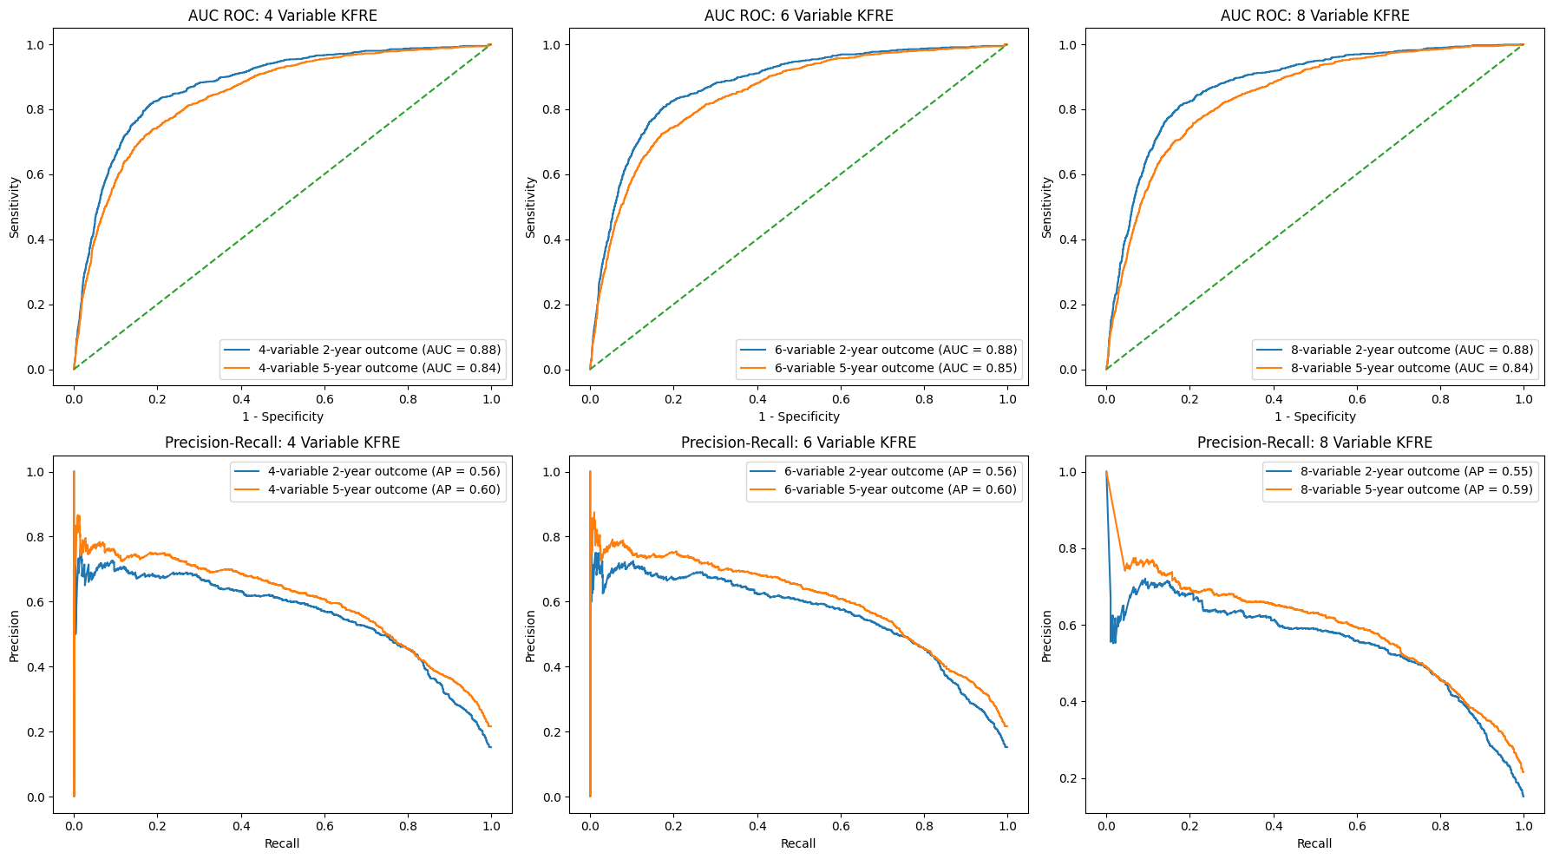
Results
Metrics | 2_year_4_var_kfre | 5_year_4_var_kfre | 2_year_6_var_kfre | 5_year_6_var_kfre | 2_year_8_var_kfre | 5_year_8_var_kfre
Precision/PPV | 0.614641 | 0.590909 | 0.616874 | 0.593812 | 0.589202 | 0.558601
Average Precision | 0.559144 | 0.602071 | 0.559212 | 0.603624 | 0.548023 | 0.587199
Sensitivity | 0.445892 | 0.641297 | 0.446894 | 0.635659 | 0.503006 | 0.675123
Specificity | 0.949919 | 0.87767 | 0.950278 | 0.880194 | 0.937175 | 0.85301
AUC ROC | 0.875196 | 0.844687 | 0.875311 | 0.84521 | 0.877136 | 0.843695
Brier Score | 0.091249 | 0.137478 | 0.091271 | 0.136473 | 0.096593 | 0.148403

Slide 10

Results

Slide 11
References
Tangri N, Grams ME, Levey AS, Coresh J, Appel LJ, Astor BC, Chodick G, Collins AJ, Djurdjev O, Elley CR, Evans M, Garg AX, Hallan SI, Inker LA, Ito S, Jee SH, Kovesdy CP, Kronenberg F, Heerspink HJL, Marks A, Nadkarni GN, Navaneethan SD, Nelson RG, Titze S, Sarnak MJ, Stengel B, Woodward M, Iseki K, for the CKD Prognosis Consortium. (2016). Multinational assessment of accuracy of equations for predicting risk of kidney failure: A meta-analysis. JAMA, 315(2), 164–174. doi: 10.1001/jama.2015.18202.
Tangri, N., Stevens, L. A., Griffith, J., Tighiouart, H., Djurdjev, O., Naimark, D., Levin, A., & Levey, A. S. (2011). A predictive model for progression of chronic kidney disease to kidney failure. JAMA, 305(15), 1553-1559. doi: 10.1001/jama.2011.451.
Shpaner, L. (2024). kfre: A Python library for reproducing Kidney Failure Risk Equations (KFRE) (Version 0.1.12) [Computer software]. Zenodo. https://doi.org/10.5281/zenodo.11100222
Kang MW, Tangri N, Kim YC, An JN, Lee J, Li L, Oh YK, Kim DK, Joo KW, Kim YS, Lim CS, Lee JP. (2020). An independent validation of the kidney failure risk equation in an Asian population. Scientific Reports,10(1), 12920. doi: 10.1038/s41598-020-69715-3.

Slide 12
Appendix

Slide 13
Descriptive Statistics
 | Age | GFR | ACR | Ca | P | Alb | TCO2 | ESRD_dur
count | 16619 | 16619 | 16619 | 16619 | 16619 | 16619 | 16619 | 16619
mean | 54.43 | 66.70 | 727.43 | 9.14 | 3.62 | 4.04 | 26.13 | 1385.88
std | 17.24 | 31.13 | 1760.78 | 0.67 | 0.84 | 0.61 | 3.99 | 1444.12
min | 18 | 2.237830735 | 0 | 3.5 | 0 | 0.3 | 3 | 1
25% | 43 | 46.94 | 25.28 | 8.8 | 3.1 | 3.8 | 24 | 241
50% | 57 | 67.84 | 120.86 | 9.2 | 3.5 | 4.2 | 27 | 868
75% | 68 | 85.13 | 642 | 9.6 | 4 | 4.4 | 29 | 2091.50
max | 97 | 415.04 | 60323.44 | 14.8 | 15.5 | 5.7 | 59 | 5892

Slide 14
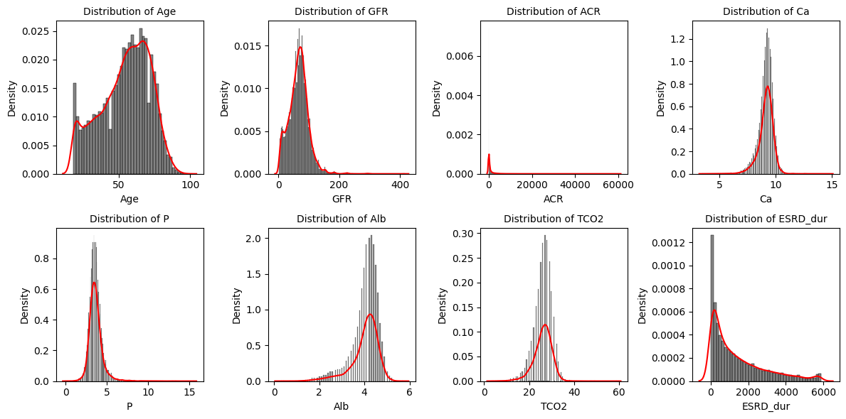
Descriptive Statistics

Slide 15
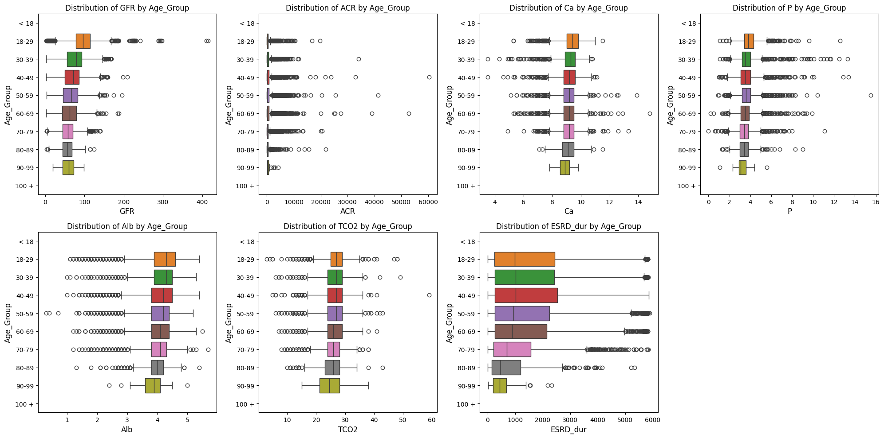
Descriptive Statistics

Slide 16
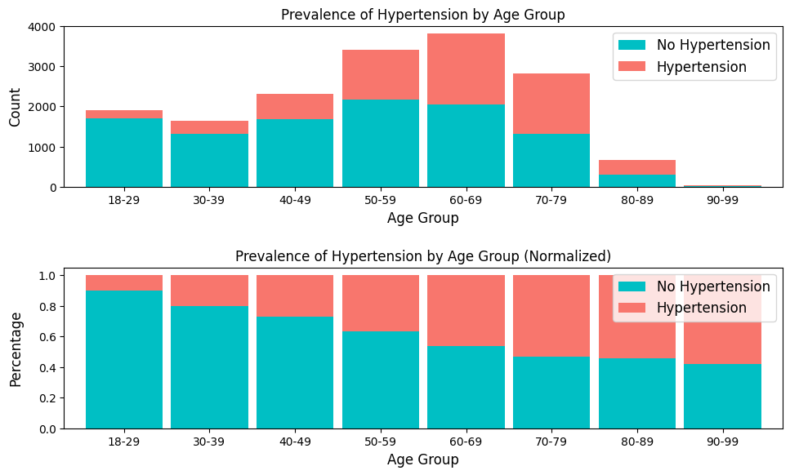
Age-Related Distributions
Age_Group | No Hypertension | Hypertension | Total | No Hypertension_% | Hypertension_%
18-29 | 1,711 | 193 | 1,904 | 89.86 | 10.14
30-39 | 1,311 | 335 | 1,646 | 79.65 | 20.35
40-49 | 1,682 | 633 | 2,315 | 72.66 | 27.34
50-59 | 2,166 | 1,247 | 3,413 | 63.46 | 36.54
60-69 | 2,046 | 1,766 | 3,812 | 53.67 | 46.33
70-79 | 1,322 | 1,505 | 2,827 | 46.76 | 53.24
80-89 | 304 | 360 | 664 | 45.78 | 54.22
90-99 | 16 | 22 | 38 | 42.11 | 57.89
Total | 10,558 | 6,061 | 16,619 | 63.53 | 36.47

Slide 17
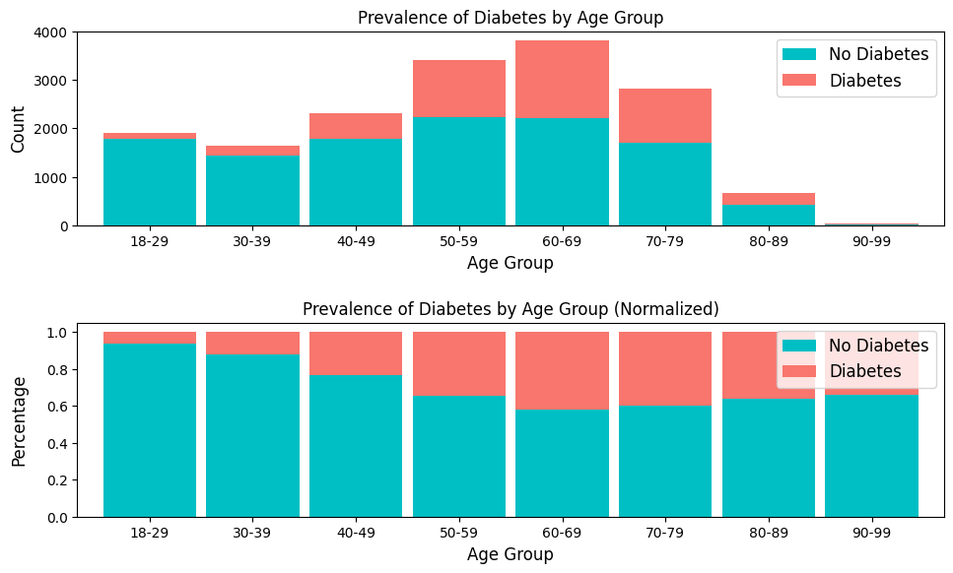
Age-Related Distributions
Age_Group | No Diabetes | Diabetes | Total | No Diabetes_% | Diabetes_%
18-29 | 1,785 | 119 | 1,904 | 93.75 | 6.25
30-39 | 1,444 | 202 | 1,646 | 87.73 | 12.27
40-49 | 1,776 | 539 | 2,315 | 76.72 | 23.28
50-59 | 2,235 | 1,178 | 3,413 | 65.48 | 34.52
60-69 | 2,216 | 1,596 | 3,812 | 58.13 | 41.87
70-79 | 1,695 | 1,132 | 2,827 | 59.96 | 40.04
80-89 | 423 | 241 | 664 | 63.70 | 36.30
90-99 | 25 | 13 | 38 | 65.79 | 34.21
Total | 11,599 | 5,020 | 16,619 | 69.79 | 30.21

Slide 18
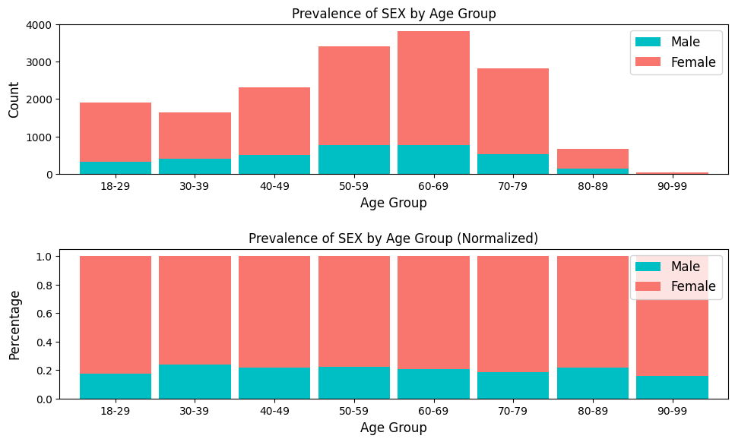
Age-Related Distributions
Age_Group | Male | Female | Total | Male_% | Female_%
18-29 | 328 | 1,576 | 1,904 | 17.23 | 82.77
30-39 | 396 | 1,250 | 1,646 | 24.06 | 75.94
40-49 | 508 | 1,807 | 2,315 | 21.94 | 78.06
50-59 | 764 | 2,649 | 3,413 | 22.38 | 77.62
60-69 | 779 | 3,033 | 3,812 | 20.44 | 79.56
70-79 | 527 | 2,300 | 2,827 | 18.64 | 81.36
80-89 | 143 | 521 | 664 | 21.54 | 78.46
90-99 | 6 | 32 | 38 | 15.79 | 84.21
Total | 3,451 | 13,168 | 16,619 | 20.77 | 79.23

Slide 19
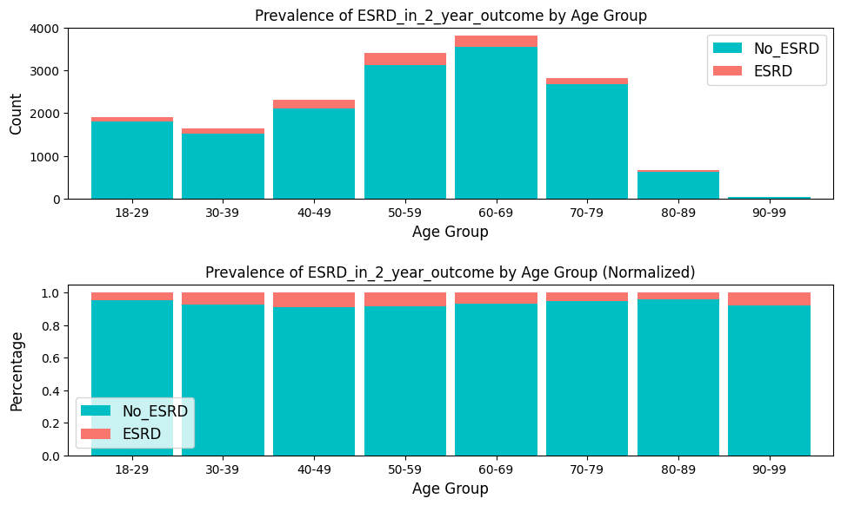
Age-Related Distributions
Age_Group | No_ESRD | ESRD | Total | No_ESRD_% | ESRD_%
18-29 | 1,808 | 96 | 1,904 | 94.96 | 5.04
30-39 | 1,526 | 120 | 1,646 | 92.71 | 7.29
40-49 | 2,099 | 216 | 2,315 | 90.67 | 9.33
50-59 | 3,121 | 292 | 3,413 | 91.44 | 8.56
60-69 | 3,544 | 268 | 3,812 | 92.97 | 7.03
70-79 | 2,673 | 154 | 2,827 | 94.55 | 5.45
80-89 | 634 | 30 | 664 | 95.48 | 4.52
90-99 | 35 | 3 | 38 | 92.11 | 7.89
Total | 15,440 | 1,179 | 16,619 | 92.91 | 7.09

Slide 20
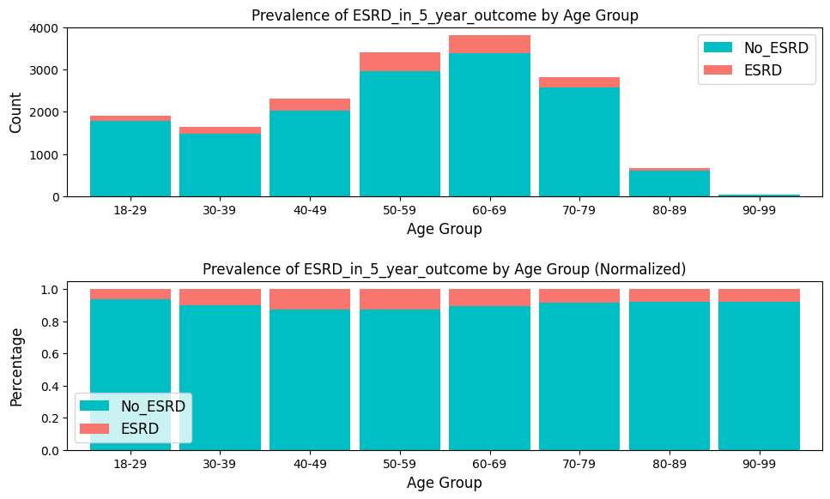
Age-Related Distributions
Age_Group | No_ESRD | ESRD | Total | No_ESRD_% | ESRD_%
18-29 | 1,778 | 126 | 1,904 | 93.38 | 6.62
30-39 | 1,482 | 164 | 1,646 | 90.04 | 9.96
40-49 | 2,019 | 296 | 2,315 | 87.21 | 12.79
50-59 | 2,970 | 443 | 3,413 | 87.02 | 12.98
60-69 | 3,395 | 417 | 3,812 | 89.06 | 10.94
70-79 | 2,586 | 241 | 2,827 | 91.48 | 8.52
80-89 | 610 | 54 | 664 | 91.87 | 8.13
90-99 | 35 | 3 | 38 | 92.11 | 7.89
Total | 14,875 | 1,744 | 16,619 | 89.51 | 10.49

Slide 21
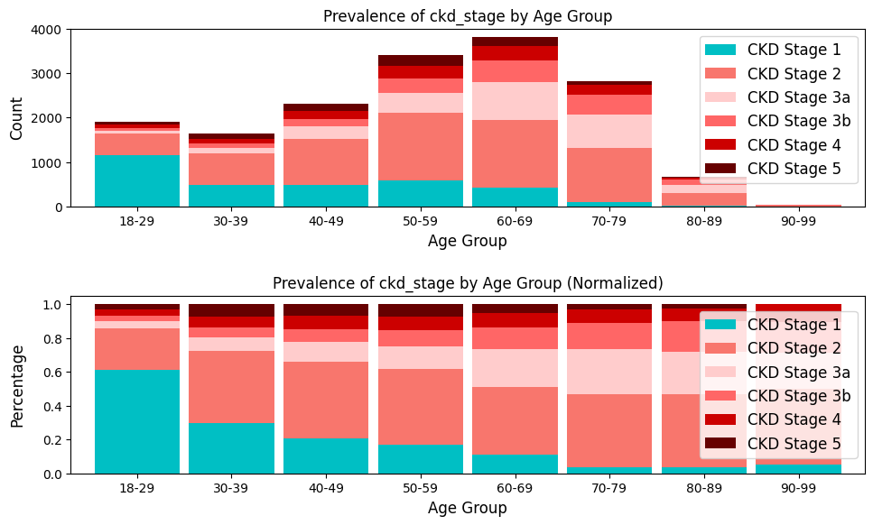
Age-Related Distributions
Age_Group | CKD Stage 1 | CKD Stage 2 | CKD Stage 3a | CKD Stage 3b | CKD Stage 4 | CKD Stage 5 | Total | CKD Stage 1_% | CKD Stage 2_% | CKD Stage 3a_% | CKD Stage 3b_% | CKD Stage 4_% | CKD Stage 5_%
18-29 | 1,165 | 467 | 74 | 68.00 | 66.00 | 64.00 | 1,904 | 61 | 25 | 3.89 | 3.57 | 3.47 | 3
30-39 | 488 | 703 | 131 | 99.00 | 100.00 | 125.00 | 1,646 | 30 | 43 | 7.96 | 6.01 | 6.08 | 8
40-49 | 476 | 1,047 | 277 | 172.00 | 178.00 | 165.00 | 2,315 | 21 | 45 | 11.97 | 7.43 | 7.69 | 7
50-59 | 581 | 1,523 | 457 | 315.00 | 289.00 | 248.00 | 3,413 | 17 | 45 | 13.39 | 9.23 | 8.47 | 7
60-69 | 421 | 1,529 | 843 | 494.00 | 322.00 | 203.00 | 3,812 | 11 | 40 | 22.11 | 12.96 | 8.45 | 5
70-79 | 105 | 1,216 | 752 | 442.00 | 219.00 | 93.00 | 2,827 | 4 | 43 | 26.60 | 15.63 | 7.75 | 3
80-89 | 24 | 286 | 165 | 123.00 | 48.00 | 18.00 | 664 | 4 | 43 | 24.85 | 18.52 | 7.23 | 3
90-99 | 2 | 17 | 8 | 7.00 | 4.00 | - | 38 | 5 | 45 | 21.05 | 18.42 | 10.53 | -
Total | 3,262 | 6,788 | 2,707 | 1,720.00 | 1,226.00 | 916.00 | 16,619 | 20 | 41 | 16.29 | 10.35 | 7.38 | 6

Slide 22
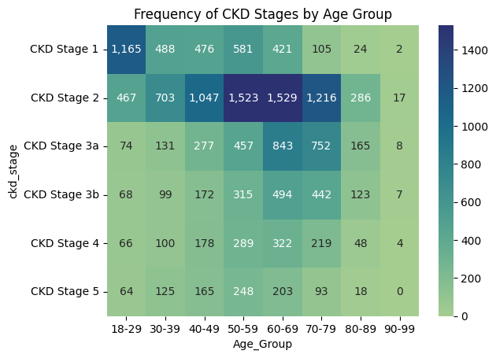
Descriptive Statistics
Key Observations:
Stage 1 CKD is most common in the 18-29 age group with 1,165 cases, and decreases significantly in older age groups.
Stage 2 CKD shows a peak in the 60-69 age group, with 1,529 cases, and remains relatively high in adjacent age groups (50-79 years).
Stage 3 CKD (both 3a and 3b) becomes more prevalent in middle to older age groups, particularly from 50-79 years.
Stages 4 and 5 CKD are less frequent across all age groups, but Stage 4 sees an increase in the 60-69 age group and remains higher in older populations.
Clinical Implications:
The data suggests that early-stage CKD is more common in younger adults, while later stages are more prevalent in older populations.
This pattern may reflect the progressive nature of CKD and the increasing risk with age.
Considerations:
Future studies could focus on understanding the factors
contributing to the peak in Stage 2 CKD in the 60-69 age group.
Intervention strategies might be tailored according to the age group and CKD stage distribution to improve patient outcomes.

Slide 23
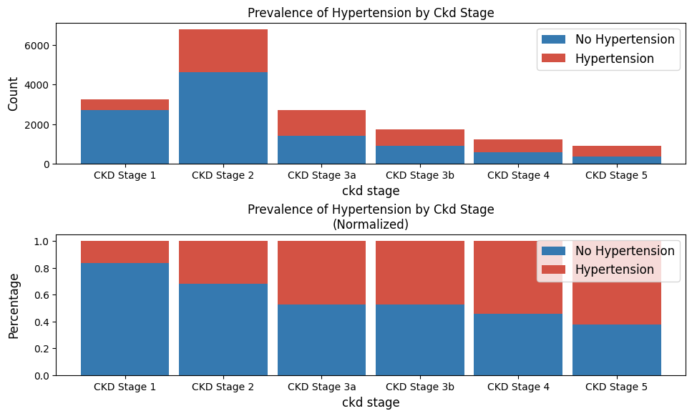
Age-Related Distributions
ckd_stage | No Hypertension | Hypertension | Total | No Hypertension_% | Hypertension_%
CKD Stage 1 | 2,715 | 547 | 3,262 | 83.23 | 16.77
CKD Stage 2 | 4,610 | 2,178 | 6,788 | 67.91 | 32.09
CKD Stage 3a | 1,423 | 1,284 | 2,707 | 52.57 | 47.43
CKD Stage 3b | 906 | 814 | 1,720 | 52.67 | 47.33
CKD Stage 4 | 557 | 669 | 1,226 | 45.43 | 54.57
CKD Stage 5 | 347 | 569 | 916 | 37.88 | 62.12
Total | 10,558 | 6,061 | 16,619 | 63.53 | 36.47

Slide 24
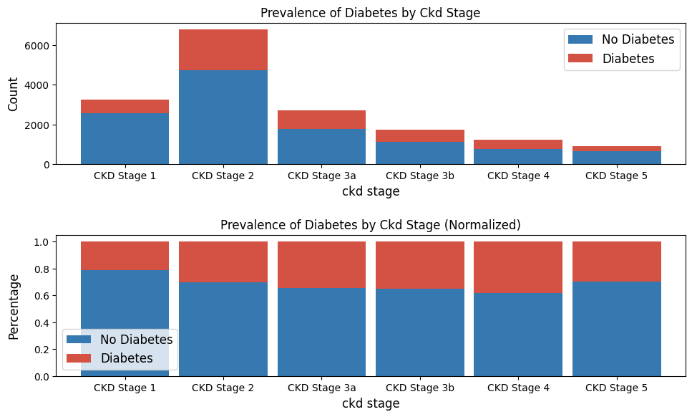
Age-Related Distributions
ckd_stage | No Diabetes | Diabetes | Total | No Diabetes_% | Diabetes_%
CKD Stage 1 | 2,571 | 691 | 3,262 | 78.82 | 21.18
CKD Stage 2 | 4,740 | 2,048 | 6,788 | 69.83 | 30.17
CKD Stage 3a | 1,776 | 931 | 2,707 | 65.61 | 34.39
CKD Stage 3b | 1,114 | 606 | 1,720 | 64.77 | 35.23
CKD Stage 4 | 757 | 469 | 1,226 | 61.75 | 38.25
CKD Stage 5 | 641 | 275 | 916 | 69.98 | 30.02
Total | 11,599 | 5,020 | 16,619 | 69.79 | 30.21

Slide 25
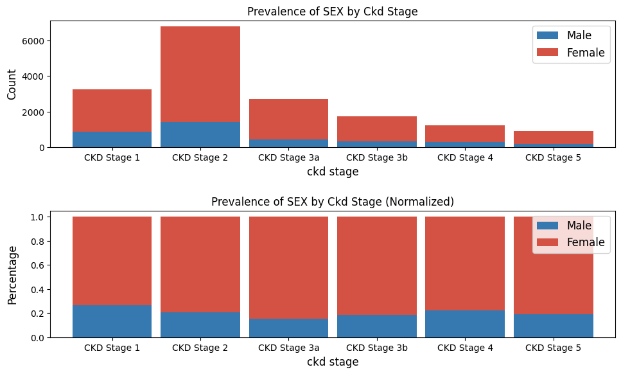
Age-Related Distributions
ckd_stage | Male | Female | Total | Male_% | Female_%
CKD Stage 1 | 856 | 2,406 | 3,262 | 26.24 | 73.76
CKD Stage 2 | 1,413 | 5,375 | 6,788 | 20.82 | 79.18
CKD Stage 3a | 412 | 2,295 | 2,707 | 15.22 | 84.78
CKD Stage 3b | 322 | 1,398 | 1,720 | 18.72 | 81.28
CKD Stage 4 | 275 | 951 | 1,226 | 22.43 | 77.57
CKD Stage 5 | 173 | 743 | 916 | 18.89 | 81.11
Total | 3,451 | 13,168 | 16,619 | 20.77 | 79.23

Slide 26
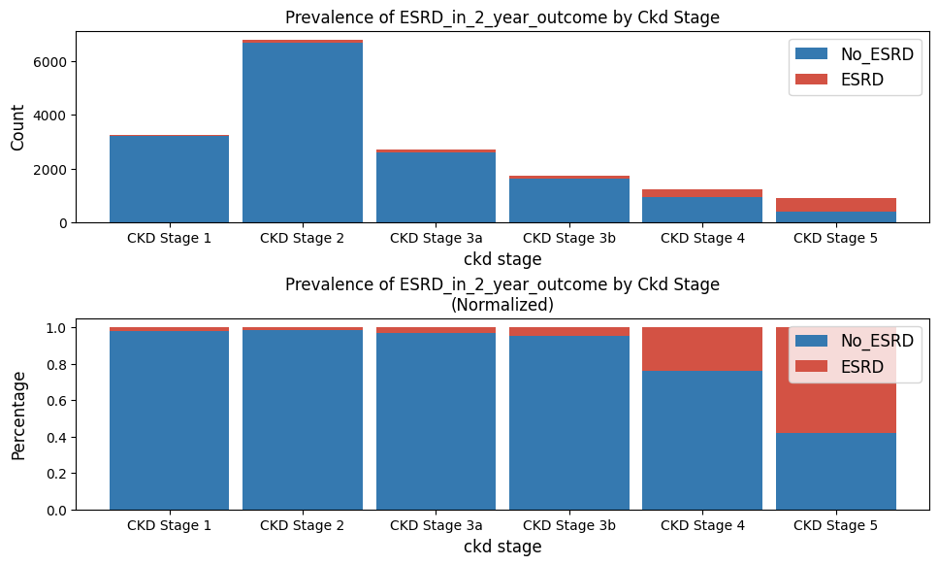
Age-Related Distributions
ckd_stage | No_ESRD | ESRD | Total | No_ESRD_% | ESRD_%
CKD Stage 1 | 3,199 | 63 | 3,262 | 98.07 | 1.93
CKD Stage 2 | 6,670 | 118 | 6,788 | 98.26 | 1.74
CKD Stage 3a | 2,616 | 91 | 2,707 | 96.64 | 3.36
CKD Stage 3b | 1,636 | 84 | 1,720 | 95.12 | 4.88
CKD Stage 4 | 933 | 293 | 1,226 | 76.10 | 23.90
CKD Stage 5 | 386 | 530 | 916 | 42.14 | 57.86
Total | 15,440 | 1,179 | 16,619 | 92.91 | 7.09

Slide 27
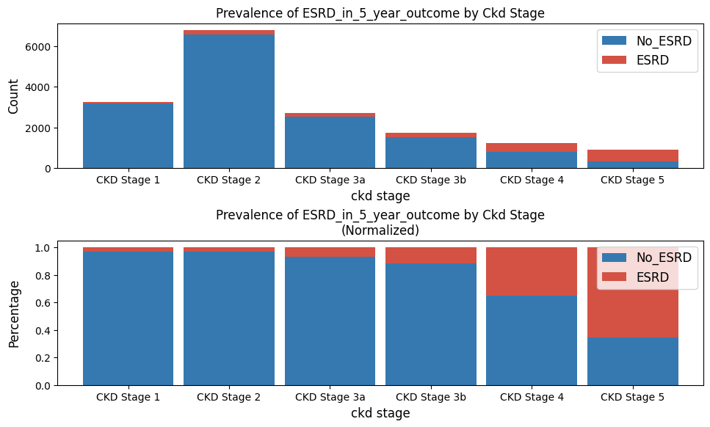
Age-Related Distributions
ckd_stage | No_ESRD | ESRD | Total | No_ESRD_% | ESRD_%
CKD Stage 1 | 3,160 | 102 | 3,262 | 96.87 | 3.13
CKD Stage 2 | 6,565 | 223 | 6,788 | 96.71 | 3.29
CKD Stage 3a | 2,523 | 184 | 2,707 | 93.20 | 6.80
CKD Stage 3b | 1,516 | 204 | 1,720 | 88.14 | 11.86
CKD Stage 4 | 797 | 429 | 1,226 | 65.01 | 34.99
CKD Stage 5 | 314 | 602 | 916 | 34.28 | 65.72
Total | 14,875 | 1,744 | 16,619 | 89.51 | 10.49

